Slide 1
坐标与变换

Slide 2
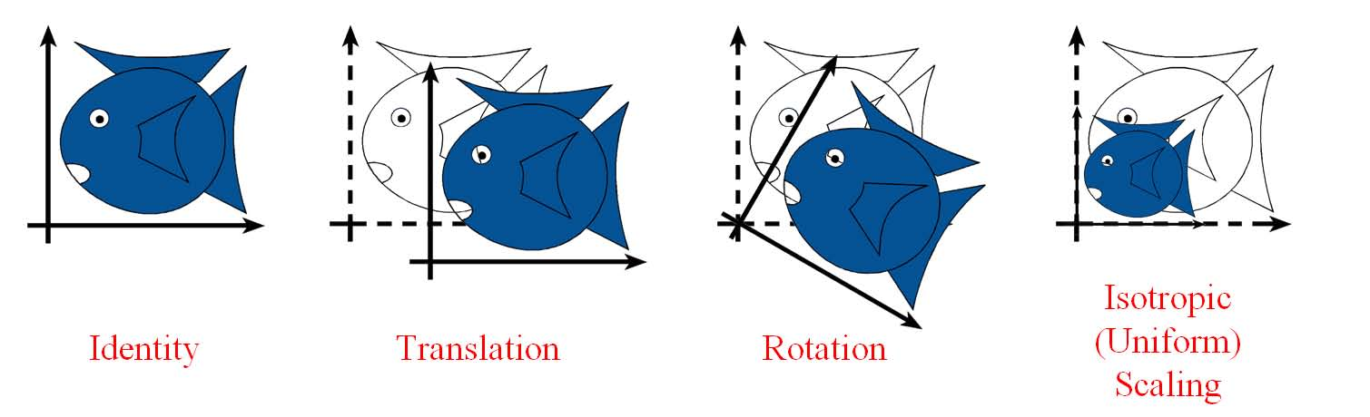
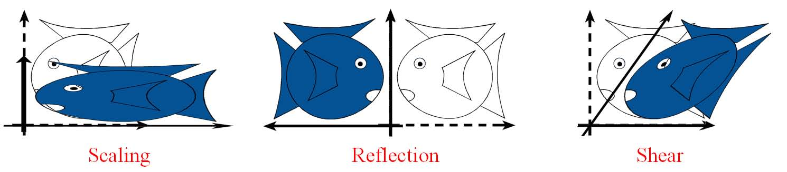
Affine transformations
Include all linear transformations
Applied to the vector basis
Plus translation

Slide 3
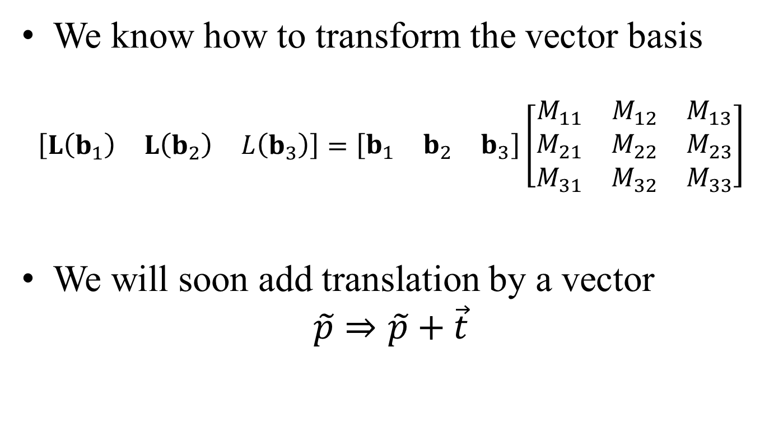
Matrix notation
We know how to transform the vector basis
$$\left[\begin{matrix}L\left(b_{1}\right) & L\left(b_{2}\right) & L\left(b_{3}\right)\end{matrix}\right]=\left[\begin{matrix}b_{1} & b_{2} & b_{3}\end{matrix}\right]\left[\begin{matrix}M_{11} & M_{12} & M_{13} \\ M_{21} & M_{22} & M_{23} \\ M_{31} & M_{32} & M_{33}\end{matrix}\right]$$
We will soon add translation by a vector
$$\tilde{p}⇒\tilde{p}+\vec{t}$$

Slide 4
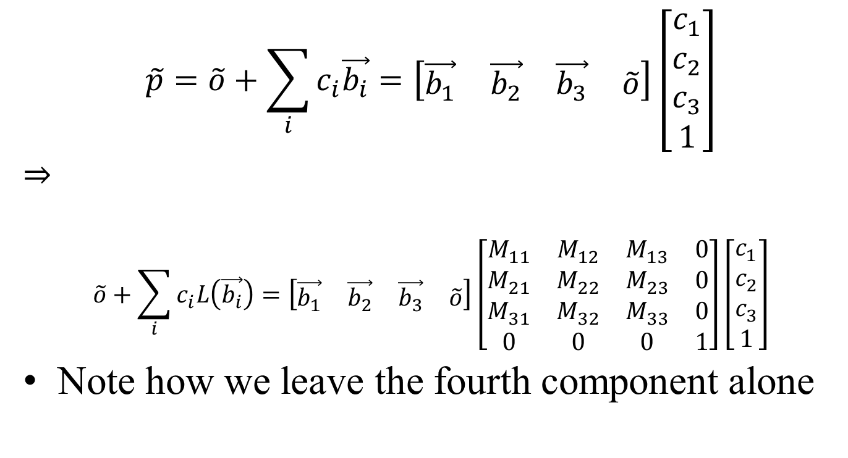
Linear component
$$\tilde{p}=\tilde{o}+\sum_{i}{c_{i}\vec{b_{i}}}=\left[\begin{matrix}\vec{b_{1}} & \vec{b_{2}} & \vec{b_{3}} & \tilde{o}\end{matrix}\right]\left[\begin{matrix}c_{1} \\ c_{2} \\ c_{3} \\ 1\end{matrix}\right]$$
$$⇒$$
$$\tilde{o}+\sum_{i}{c_{i}L\left(\vec{b_{i}}\right)}=\left[\begin{matrix}\vec{b_{1}} & \vec{b_{2}} & \vec{b_{3}} & \tilde{o}\end{matrix}\right]\left[\begin{matrix}M_{11} & M_{12} & M_{13} & 0 \\ M_{21} & M_{22} & M_{23} & 0 \\ M_{31} & M_{32} & M_{33} & 0 \\ 0 & 0 & 0 & 1\end{matrix}\right]\left[\begin{matrix}c_{1} \\ c_{2} \\ c_{3} \\ 1\end{matrix}\right]$$
Note how we leave the fourth component alone

Slide 5
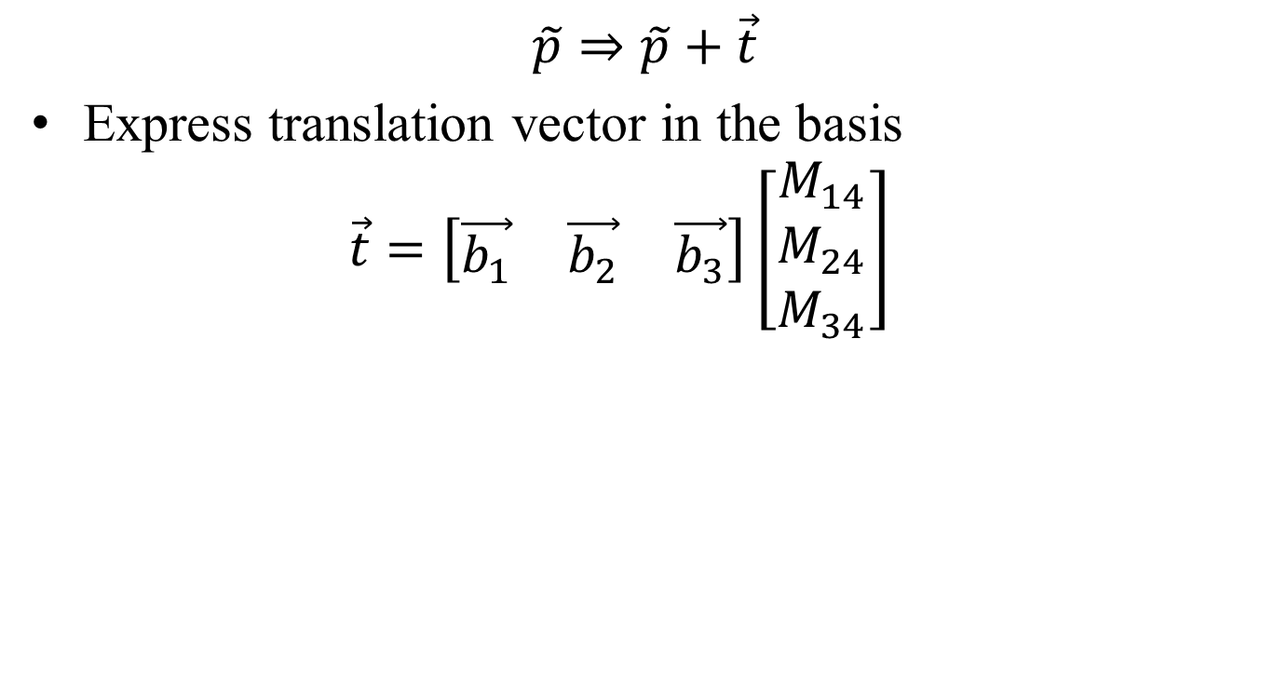
Translation component
$$\tilde{p}⇒\tilde{p}+\vec{t}$$
Express translation vector in the basis $\vec{t}=\left[\begin{matrix}\vec{b_{1}} & \vec{b_{2}} & \vec{b_{3}}\end{matrix}\right]\left[\begin{matrix}M_{14} \\ M_{24} \\ M_{34}\end{matrix}\right]$

Slide 6
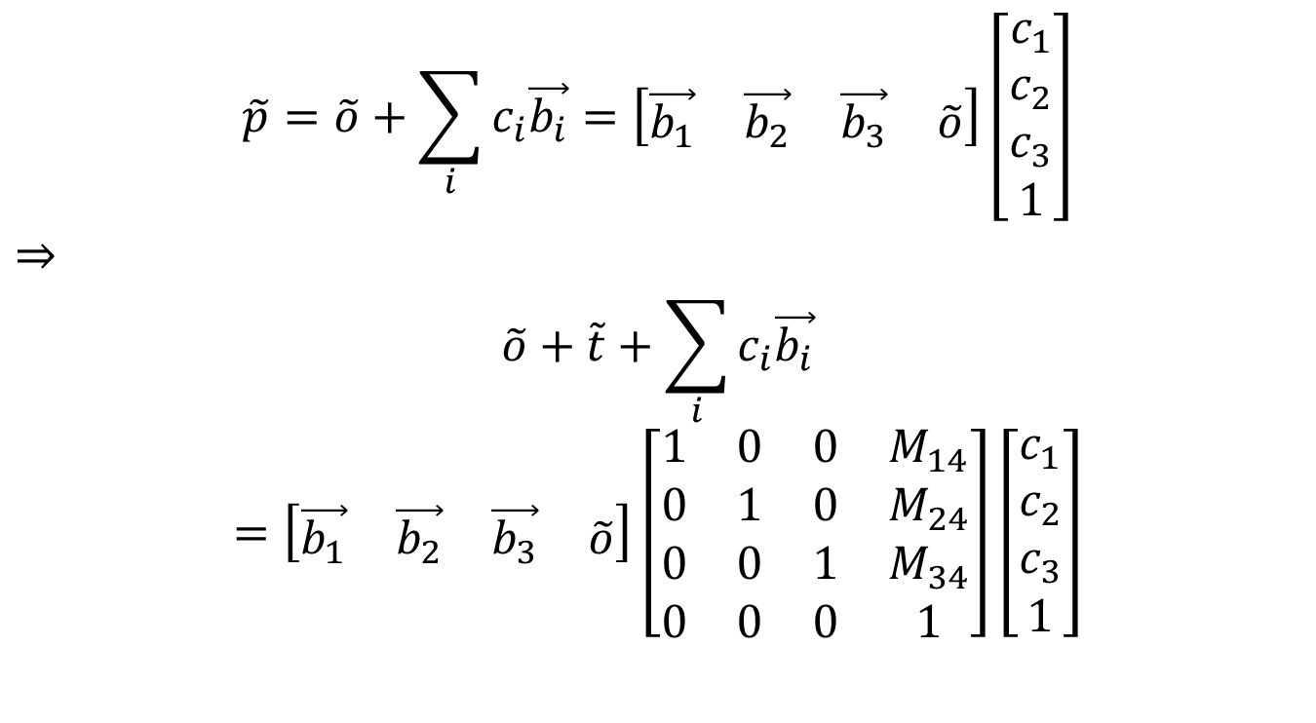
Translation
$$\tilde{p}=\tilde{o}+\sum_{i}{c_{i}\vec{b_{i}}}=\left[\begin{matrix}\vec{b_{1}} & \vec{b_{2}} & \vec{b_{3}} & \tilde{o}\end{matrix}\right]\left[\begin{matrix}c_{1} \\ c_{2} \\ c_{3} \\ 1\end{matrix}\right]$$
$$⇒$$
$$\tilde{o}+\tilde{t}+\sum_{i}{c_{i}\vec{b_{i}}}$$
$$=\left[\begin{matrix}\vec{b_{1}} & \vec{b_{2}} & \vec{b_{3}} & \tilde{o}\end{matrix}\right]\left[\begin{matrix}1 & 0 & 0 & M_{14} \\ 0 & 1 & 0 & M_{24} \\ 0 & 0 & 1 & M_{34} \\ 0 & 0 & 0 & 1\end{matrix}\right]\left[\begin{matrix}c_{1} \\ c_{2} \\ c_{3} \\ 1\end{matrix}\right]$$

Slide 7
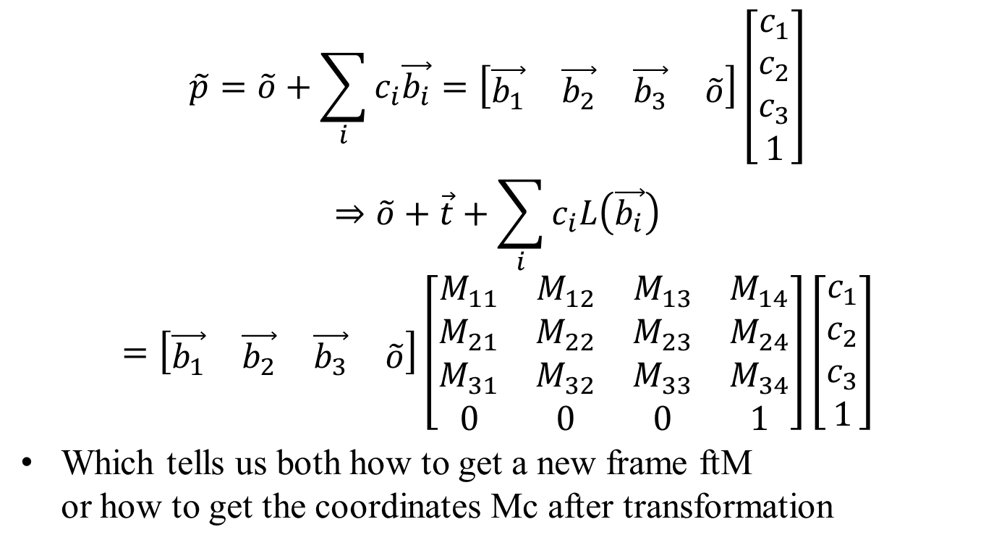
Full Affine Expression
$$\tilde{p}=\tilde{o}+\sum_{i}{c_{i}\vec{b_{i}}}=\left[\begin{matrix}\vec{b_{1}} & \vec{b_{2}} & \vec{b_{3}} & \tilde{o}\end{matrix}\right]\left[\begin{matrix}c_{1} \\ c_{2} \\ c_{3} \\ 1\end{matrix}\right]$$
$$⇒\tilde{o}+\vec{t}+\sum_{i}{c_{i}L\left(\vec{b_{i}}\right)}$$
$$=\left[\begin{matrix}\vec{b_{1}} & \vec{b_{2}} & \vec{b_{3}} & \tilde{o}\end{matrix}\right]\left[\begin{matrix}M_{11} & M_{12} & M_{13} & M_{14} \\ M_{21} & M_{22} & M_{23} & M_{24} \\ M_{31} & M_{32} & M_{33} & M_{34} \\ 0 & 0 & 0 & 1\end{matrix}\right]\left[\begin{matrix}c_{1} \\ c_{2} \\ c_{3} \\ 1\end{matrix}\right]$$
Which tells us both how to get a new frame ftM or how to get the coordinates Mc after transformation

Slide 8
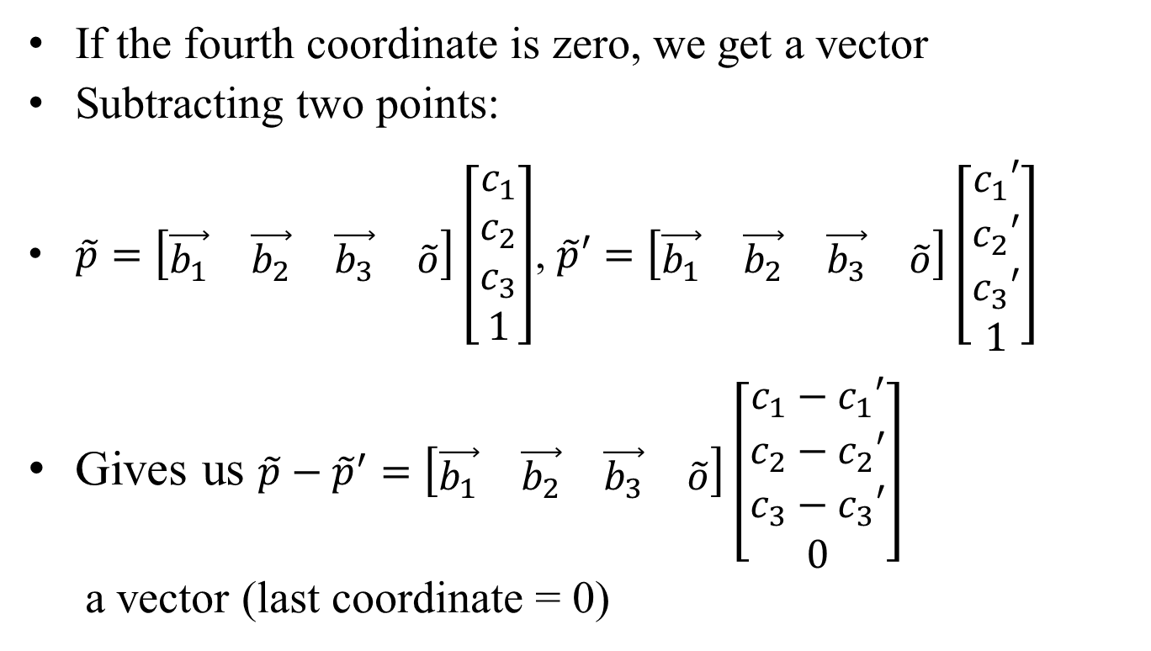
More notation properties
If the fourth coordinate is zero, we get a vector
Subtracting two points:
$\tilde{p}=\left[\begin{matrix}\vec{b_{1}} & \vec{b_{2}} & \vec{b_{3}} & \tilde{o}\end{matrix}\right]\left[\begin{matrix}c_{1} \\ c_{2} \\ c_{3} \\ 1\end{matrix}\right]$, $\tilde{p}′=\left[\begin{matrix}\vec{b_{1}} & \vec{b_{2}} & \vec{b_{3}} & \tilde{o}\end{matrix}\right]\left[\begin{matrix}c_{1}′ \\ c_{2}′ \\ c_{3}′ \\ 1\end{matrix}\right]$
Gives us $\tilde{p}−{\tilde{p}}^{′}=\left[\begin{matrix}\vec{b_{1}} & \vec{b_{2}} & \vec{b_{3}} & \tilde{o}\end{matrix}\right]\left[\begin{matrix}c_{1}−c_{1}′ \\ c_{2}−c_{2}′ \\ c_{3}−c_{3}′ \\ 0\end{matrix}\right]$
a vector (last coordinate = 0)

Slide 9
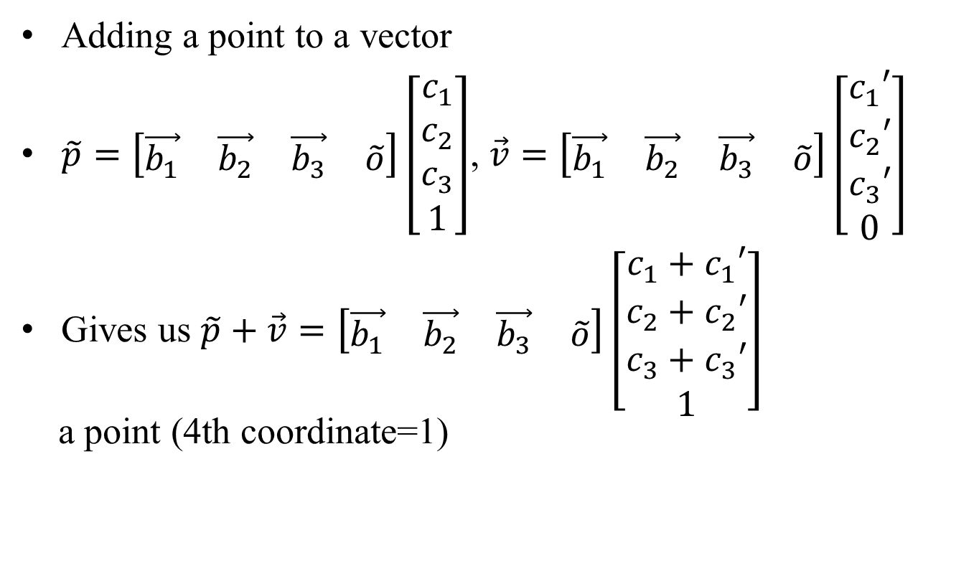
More notation properties
Adding a point to a vector
$\tilde{p}=\left[\begin{matrix}\vec{b_{1}} & \vec{b_{2}} & \vec{b_{3}} & \tilde{o}\end{matrix}\right]\left[\begin{matrix}c_{1} \\ c_{2} \\ c_{3} \\ 1\end{matrix}\right]$, $\vec{v}=\left[\begin{matrix}\vec{b_{1}} & \vec{b_{2}} & \vec{b_{3}} & \tilde{o}\end{matrix}\right]\left[\begin{matrix}c_{1}′ \\ c_{2}′ \\ c_{3}′ \\ 0\end{matrix}\right]$
Gives us $\tilde{p}+\vec{v}=\left[\begin{matrix}\vec{b_{1}} & \vec{b_{2}} & \vec{b_{3}} & \tilde{o}\end{matrix}\right]\left[\begin{matrix}c_{1}+c_{1}′ \\ c_{2}+c_{2}′ \\ c_{3}+c_{3}′ \\ 1\end{matrix}\right]$
a point (4th coordinate=1)

Slide 10
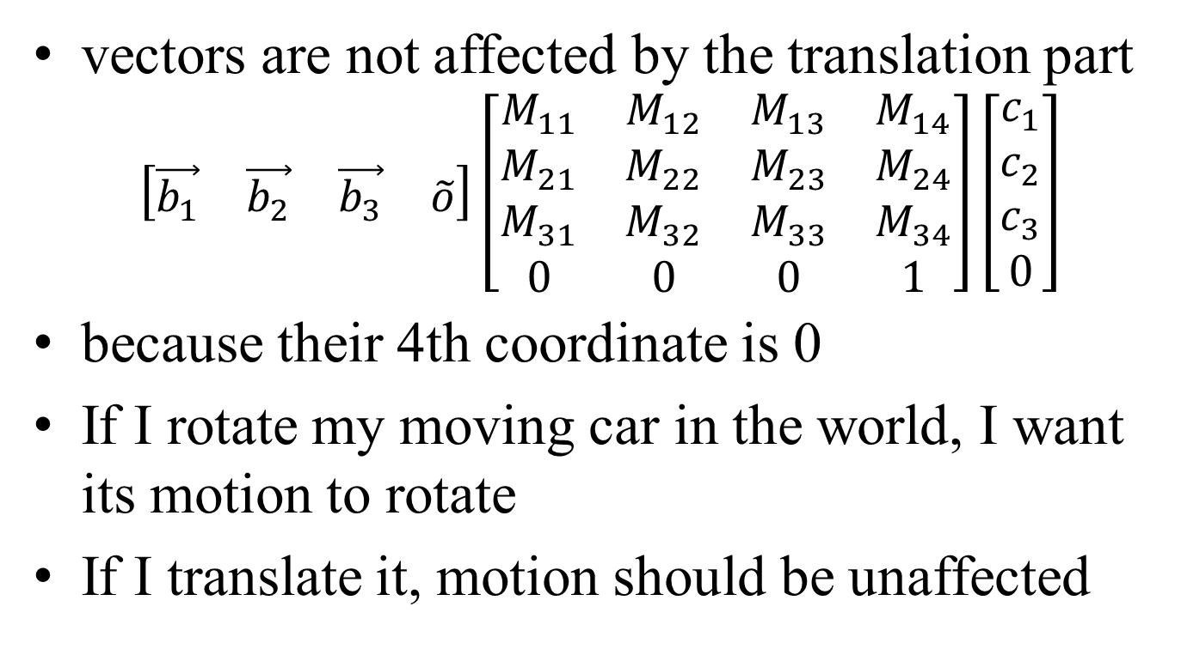
More notation properties
vectors are not affected by the translation part
$$\left[\begin{matrix}\vec{b_{1}} & \vec{b_{2}} & \vec{b_{3}} & \tilde{o}\end{matrix}\right]\left[\begin{matrix}M_{11} & M_{12} & M_{13} & M_{14} \\ M_{21} & M_{22} & M_{23} & M_{24} \\ M_{31} & M_{32} & M_{33} & M_{34} \\ 0 & 0 & 0 & 1\end{matrix}\right]\left[\begin{matrix}c_{1} \\ c_{2} \\ c_{3} \\ 0\end{matrix}\right]$$
because their 4th coordinate is 0
If I rotate my moving car in the world, I want its motion to rotate
If I translate it, motion should be unaffected

Slide 11

Frames & hierarchical modeling
Many coordinate systems (frames)
Camera
Static scene
Car
Driver
Arm
Hand
...
Need to understand nested transformations

Slide 12
Frames & hierarchical modeling
Example: what if I rotate the wheel of the moving car:
frame 1: world
frame 2: car
transformation: rotation

Slide 13
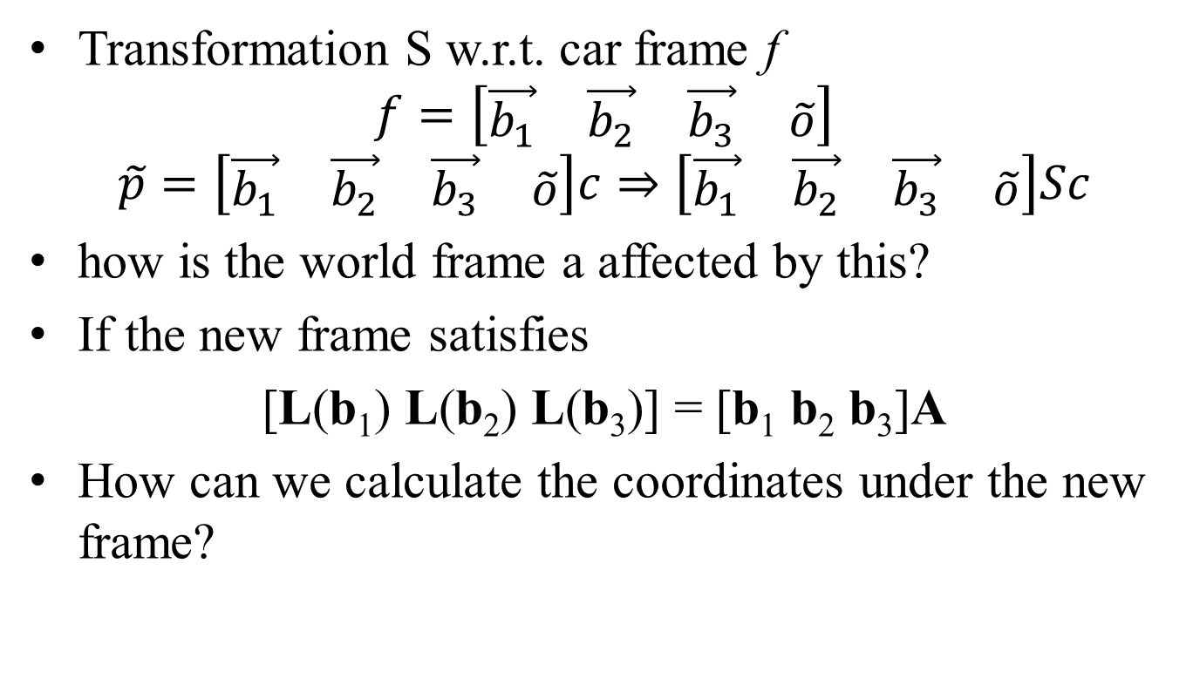
Frames & hierarchical modeling
Transformation S w.r.t. car frame f
$$f=\left[\begin{matrix}\vec{b_{1}} & \vec{b_{2}} & \vec{b_{3}} & \tilde{o}\end{matrix}\right]$$
$$\tilde{p}=\left[\begin{matrix}\vec{b_{1}} & \vec{b_{2}} & \vec{b_{3}} & \tilde{o}\end{matrix}\right]c⇒\left[\begin{matrix}\vec{b_{1}} & \vec{b_{2}} & \vec{b_{3}} & \tilde{o}\end{matrix}\right]Sc$$
how is the world frame a affected by this?
If the new frame satisfies
[L(b₁) L(b₂) L(b₃)] = [b₁ b₂ b₃]A
How can we calculate the coordinates under the new frame?

Slide 14
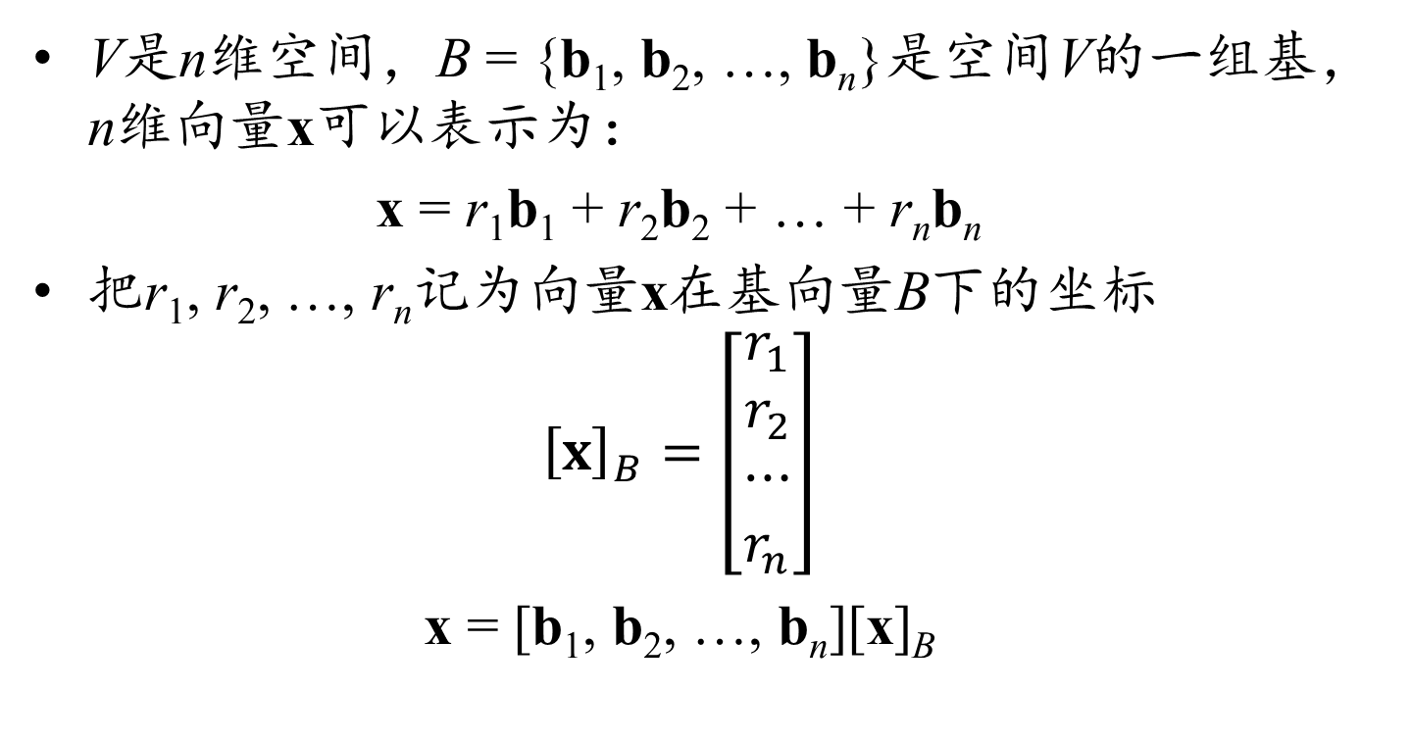
用基坐标表示向量回顾
V是n维空间，B = {b₁, b₂, …, b_{n}}是空间V的一组基，n维向量x可以表示为：
x = r₁b₁ + r₂b₂ + … + r_{n}b_{n}
把r₁, r₂, …, r_{n}记为向量x在基向量B下的坐标
$${\left[x\right]}_{B}=\left[\begin{matrix}r_{1} \\ r_{2} \\ ⋯ \\ r_{n}\end{matrix}\right]$$
x = [b₁, b₂, …, b_{n}][x]_{B}

Slide 15
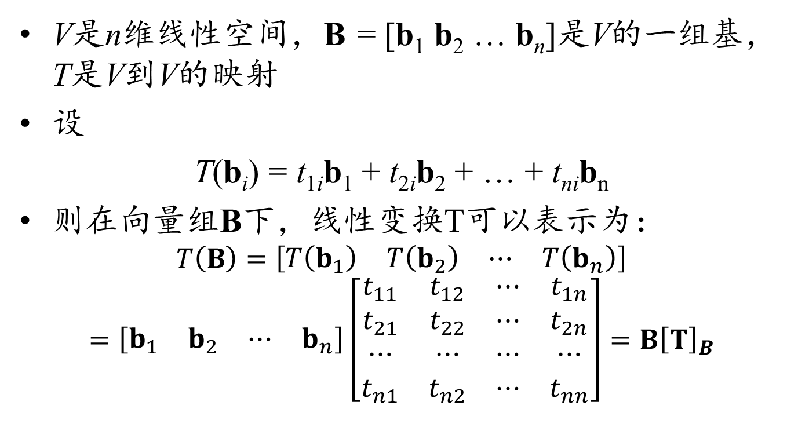
空间到自身的线性变换
V是n维线性空间，B = [b₁ b₂ … b_{n}]是V的一组基，T是V到V的映射
设
T(b_{i}) = t_{1i}b₁ + t_{2i}b₂ + … + t_{ni}b_{n}
则在向量组B下，线性变换T可以表示为：
$$T\left(B\right)=\left[\begin{matrix}T\left(b_{1}\right) & T\left(b_{2}\right) & ⋯ & T\left(b_{n}\right)\end{matrix}\right]$$
$$=\left[\begin{matrix}b_{1} & b_{2} & ⋯ & b_{n}\end{matrix}\right]\left[\begin{matrix}t_{11} & t_{12} & ⋯ & t_{1n} \\ t_{21} & t_{22} & ⋯ & t_{2n} \\ ⋯ & ⋯ & ⋯ & ⋯ \\ t_{n1} & t_{n2} & ⋯ & t_{nn}\end{matrix}\right]=B{\left[T\right]}_{B}$$

Slide 16
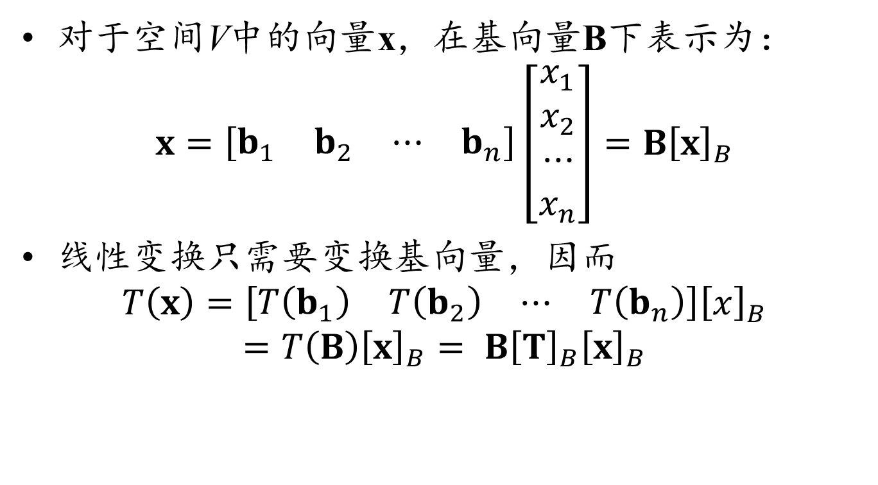
空间到自身的线性变换
对于空间V中的向量x，在基向量B下表示为：
$$x=\left[\begin{matrix}b_{1} & b_{2} & ⋯ & b_{n}\end{matrix}\right]\left[\begin{matrix}x_{1} \\ x_{2} \\ ⋯ \\ x_{n}\end{matrix}\right]=B{\left[x\right]}_{B}$$
线性变换只需要变换基向量，因而
$$T\left(x\right)=\left[\begin{matrix}T\left(b_{1}\right) & T\left(b_{2}\right) & ⋯ & T\left(b_{n}\right)\end{matrix}\right]{\left[x\right]}_{B}$$
$$=T\left(B\right){\left[x\right]}_{B}= B{\left[T\right]}_{B}{\left[x\right]}_{B}$$

Slide 17
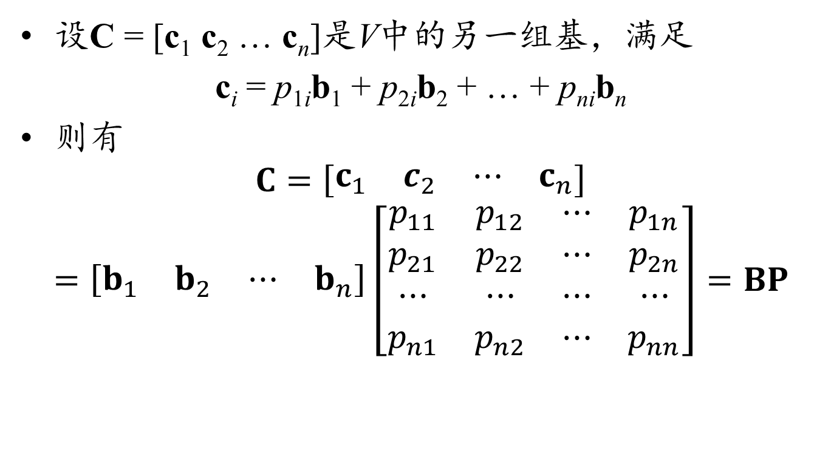
基向量的变换
设C = [c₁ c₂ … c_{n}]是V中的另一组基，满足
c_{i} = p_{1i}b₁ + p_{2i}b₂ + … + p_{ni}b_{n}
则有
$$C=\left[\begin{matrix}c_{1} & c_{2} & ⋯ & c_{n}\end{matrix}\right]$$
$$=\left[\begin{matrix}b_{1} & b_{2} & ⋯ & b_{n}\end{matrix}\right]\left[\begin{matrix}p_{11} & p_{12} & ⋯ & p_{1n} \\ p_{21} & p_{22} & ⋯ & p_{2n} \\ ⋯ & ⋯ & ⋯ & ⋯ \\ p_{n1} & p_{n2} & ⋯ & p_{nn}\end{matrix}\right]=BP$$

Slide 18
基变换与线性变换
对于同一个向量x，用不同的基向量表示：
x = B[x]_{B} = C[x]_{C} = BP[x]_{C}
两边约去B，得到：[x]_{B} = P[x]_{C}
在线性变换T下，用不同的基向量表示T(x)：
T(x) = B[T]_{B}[x]_{B} = C[T]_{C}[x]_{C} = BP[T]_{C}[x]_{C}
两边约去B，得到：[T]_{B}[x]_{B} = P[T]_{C}
即：[T]_{B}P[x]_{C}= P[T]_{C}[x]_{C}
注意到上式对任意的都成立，因而有
[T]_{C} = P^{–1}[T]_{B}P

Slide 19
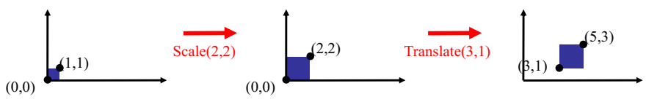
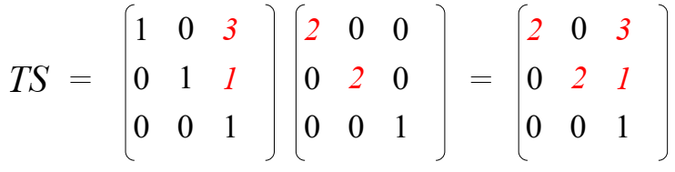
How are transforms combined?
Scale then Translate
Use matrix multiplication: p' = T(Sp) = TSp
Caution: matrix multiplication is NOT commutative!

Slide 20
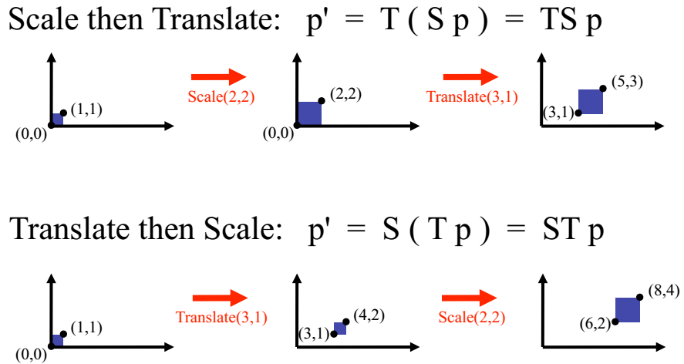
How are transforms combined?
Non-commutative Composition

Slide 21
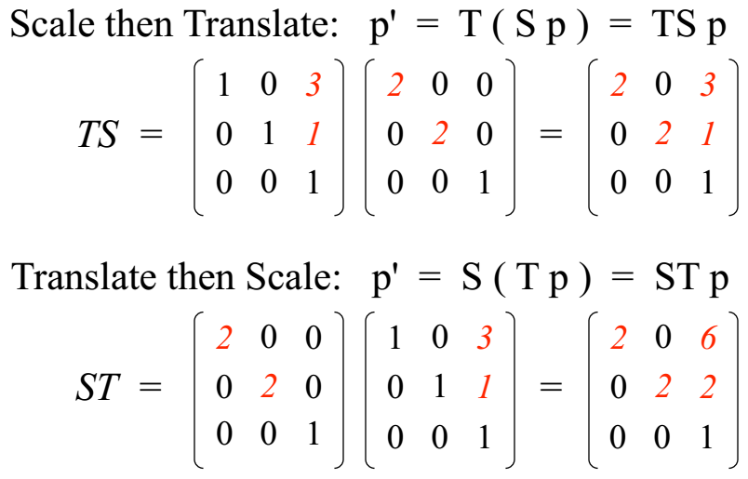
Non-commutative Composition

Slide 22
Forward reference and eye
The fourth coordinate is useful for perspective projection
Called homogeneous coordinates
homo(相同) + gene(基因) = homogeneous(齐次)

Slide 23
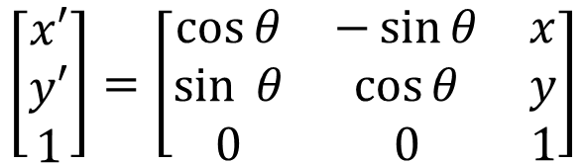
Homogeneous Coordinates
Add an extra dimension
in 2D, we use 3-vectors and 3 x 3 matrices
In 3D, we use 4-vectors and 4 x 4 matrices
Makes affine transformations linear in one higher dimension (can be represented by a matrix)
Each point has an extra value, w
You can think of it as “scale”
For all transformations except perspective, you can just set w=1 and not worry about it
$$\left[\begin{aligned}x′ \\ y′ \\ 1\end{aligned}\right]=\left[\begin{matrix}\cos{θ} & −\sin{θ} & x \\ \sin{ θ} & \cos{θ} & y \\ 0 & 0 & 1\end{matrix}\right]$$

Slide 24
Pinhole Camera

Slide 25
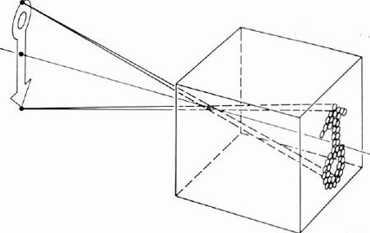
Pinhole Camera a.k.a. Camera Obscura

Slide 26
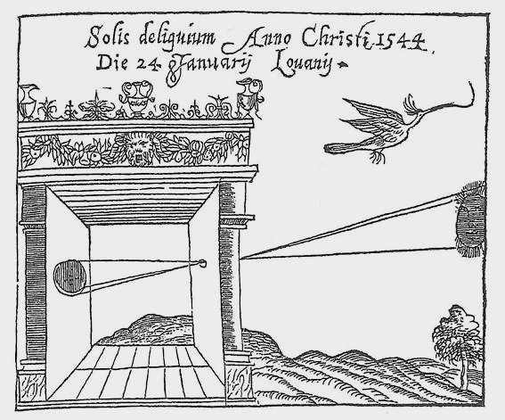
Pinhole Camera a.k.a. Camera Obscura
First mention …
First camera …
Chinese philosopher Mozi
(470 to 390 BC)
Greek philosopher Aristotle
(384 to 322 BC)

Slide 27
Pinhole Camera Terms
barrier (diaphragm)
image plane
pinhole (aperture)
digital sensor (CCD or CMOS)
real-world object
camera center (center of projection)
focal length f

Slide 28
Focal Length
What happens as we change the focal length?
object projection is half the size
real-world object
focal length 0.5 f

Slide 29
Pinhole Size
real-world object
pinhole diameter
Ideal pinhole has infinitesimally small size
In practice that is impossible.

Slide 30
Pinhole Size
What happens as we change the pinhole diameter?
real-world object
pinhole diameter

Slide 31

Pinhole Size
What happens as we change the pinhole diameter?
object projection becomes blurrier
real-world object

Slide 32
What about Light Efficiency?
real-world object
pinhole diameter
focal length f
What is the effect of doubling the pinhole diameter?
What is the effect of doubling the focal length?
→ 4x light
→ ¼x light

Slide 33
The Physical Pinhole Camera
image plane
real-world object
camera center
focal length f =1

Slide 34
The Mathematical Pinhole Camera
image plane
real-world object
camera center
focal length f = 1

Slide 35
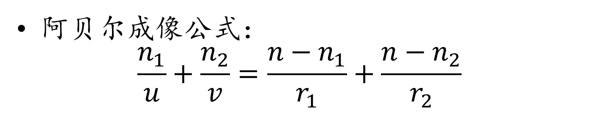
凸透镜成像
n₁
n₂
u
v
n
阿贝尔成像公式：
$$\frac{n_{1}}{u}+\frac{n_{2}}{v}=\frac{n−n_{1}}{r_{1}}+\frac{n−n_{2}}{r_{2}}$$

Slide 36

凹面镜成像
r
v
u
近轴光线成像公式：
$$\frac{1}{u}+\frac{1}{v}=\frac{2}{r}$$

Slide 37
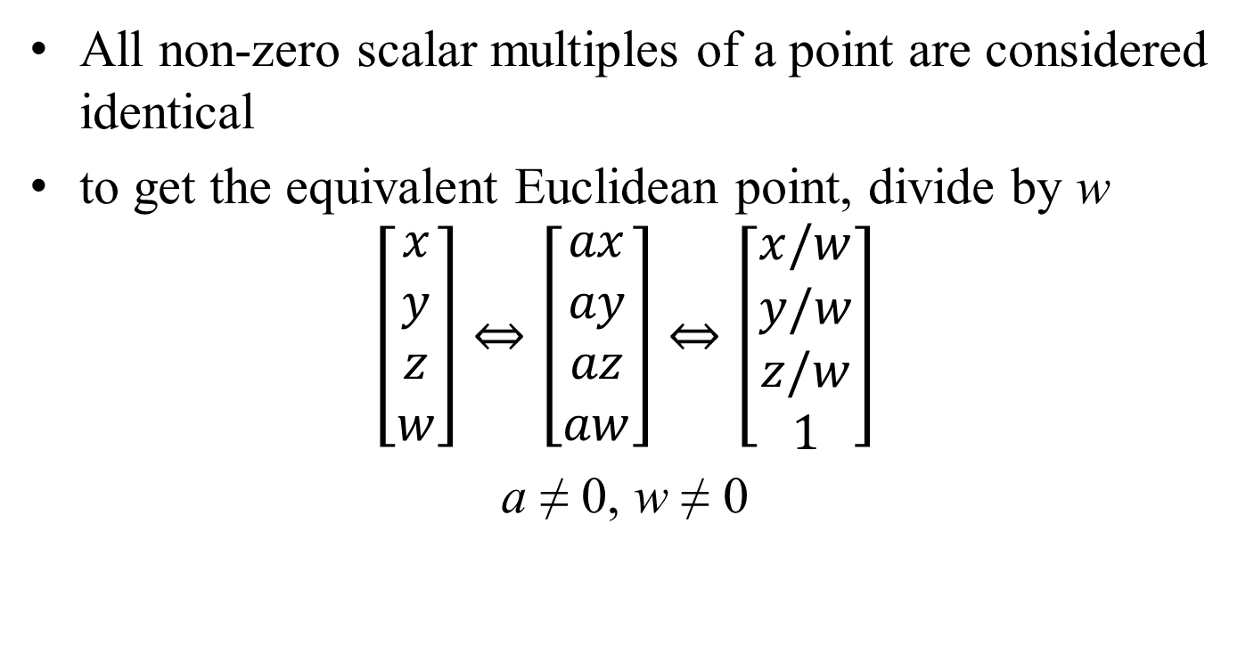
Projective Equivalence
All non-zero scalar multiples of a point are considered identical
to get the equivalent Euclidean point, divide by w
$$\left[\begin{matrix}x \\ y \\ z \\ w\end{matrix}\right]⇔\left[\begin{matrix}ax \\ ay \\ az \\ aw\end{matrix}\right]⇔\left[\begin{matrix}x/w \\ y/w \\ z/w \\ 1\end{matrix}\right]$$
a ≠ 0, w ≠ 0

Slide 38
射影变换
构成条件：
对应点的连线交于一点
原像集和像集分别在各自的平面内

Slide 39
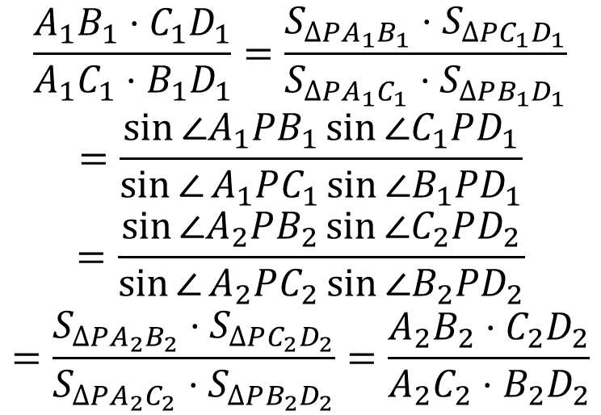
交比及其射影不变性质
$$\frac{A_{1}B_{1}⋅C_{1}D_{1}}{A_{1}C_{1}⋅B_{1}D_{1}}=\frac{S_{ΔPA_{1}B_{1}}⋅S_{ΔPC_{1}D_{1}}}{S_{ΔPA_{1}C_{1}}⋅S_{ΔPB_{1}D_{1}}}$$
$$=\frac{\sin{∠A_{1}PB_{1}}\sin{∠C_{1}PD_{1}}}{\sin{∠}A_{1}PC_{1}\sin{∠B_{1}PD_{1}}}$$
$$=\frac{\sin{∠A_{2}PB_{2}}\sin{∠C_{2}PD_{2}}}{\sin{∠}A_{2}PC_{2}\sin{∠B_{2}PD_{2}}}$$
$$=\frac{S_{ΔPA_{2}B_{2}}⋅S_{ΔPC_{2}D_{2}}}{S_{ΔPA_{2}C_{2}}⋅S_{ΔPB_{2}D_{2}}}=\frac{A_{2}B_{2}⋅C_{2}D_{2}}{A_{2}C_{2}⋅B_{2}D_{2}}$$
D₁
A₁
B₁
C₁
A₂
B₂
C₂
D₂
交比由四条线段构成，分子和分母和有一组不共点的线段
同一直线上四点的交比在射影变换下保持不变

Slide 40
帕普斯定理
C
B
A
I
G
H
D
F
E
ABC三点共线，DEF三点共线，且
AE∩BD = G, AF∩CD = H，BF∩CE = I
则GHI三点共线

Slide 41
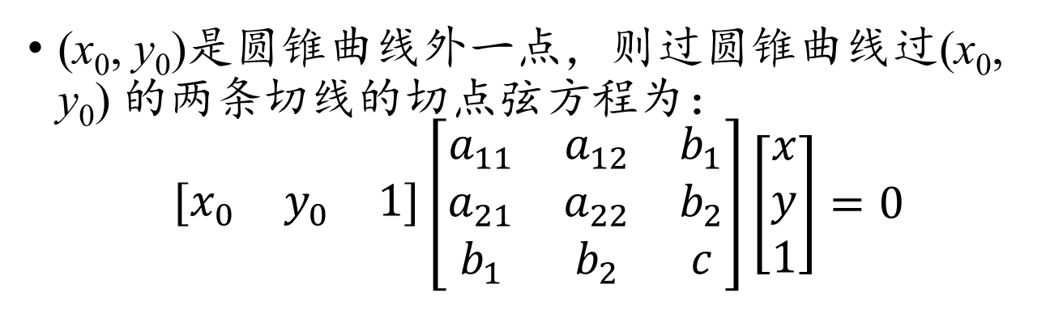
圆锥曲线的切点弦方程
(x₁, y₁)
(x₀, y₀)
(x₂, y₂)
(x₀, y₀)是圆锥曲线外一点，则过圆锥曲线过(x₀, y₀) 的两条切线的切点弦方程为：
$$\left[\begin{matrix}x_{0} & y_{0} & 1\end{matrix}\right]\left[\begin{matrix}a_{11} & a_{12} & b_{1} \\ a_{21} & a_{22} & b_{2} \\ b_{1} & b_{2} & c\end{matrix}\right]\left[\begin{matrix}x \\ y \\ 1\end{matrix}\right]=0$$

Slide 42
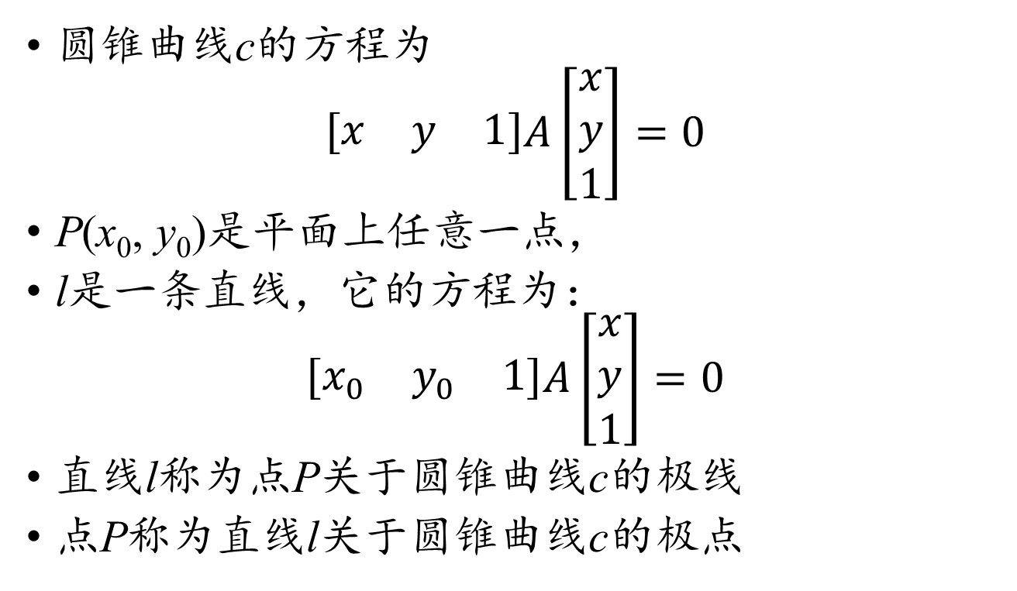
极点和极线
圆锥曲线c的方程为
$$\left[\begin{matrix}x & y & 1\end{matrix}\right]A\left[\begin{matrix}x \\ y \\ 1\end{matrix}\right]=0$$
P(x₀, y₀)是平面上任意一点，
l是一条直线，它的方程为：
$$\left[\begin{matrix}x_{0} & y_{0} & 1\end{matrix}\right]A\left[\begin{matrix}x \\ y \\ 1\end{matrix}\right]=0$$
直线l称为点P关于圆锥曲线c的极线
点P称为直线l关于圆锥曲线c的极点

Slide 43
极点与极线的性质
P₂(x₂, y₂)
P₁(x₁, y₁)
c是一条圆锥曲线，P₁和P₂是平面内两点，P₁在P₂关于c的极线上等价于P₂在P₁关于c的极线上。

Slide 44
极点与极线的性质
P₁
l₁
P₂
l₃
l₂
P₃
c是一条圆锥曲线，P₁, P₂, P₃是平面内三点，l₁, l₂和l₃分别是P₁, P₂和P₃关于圆锥曲线c的极线，则l₁, l₂和l₃三线共点等价于P₁, P₂和P₃三点共线。

Slide 45
极点与极线的性质
E
A
D
P
C
B
F
四边形ABCD内接于圆锥曲线c，AD于BC交于点P，圆锥曲线c过A和D的两条切线交于点E，过B和C的两条切线交于点F，则EF是点P关于圆锥曲线c的极线

Slide 46
帕斯卡定理
H
B
A
G
F
E
C
D
I
帕斯卡定理：六边形ABCDEF内接于圆锥曲线，AB和DE交于点G, BC和EF交于点H，CD和FA交于点I，证明：GHI三点共线

Slide 47
布里安桑定理
F
A
B
E
C
D
外切于圆锥曲线的六边形三条正对角线交于一点
证明思路：六个切点构成内接六边形，外切六边形的正对角线是内接六边形正对边交点关于圆锥曲线的极线，再利用帕斯卡定理

Slide 48
布里安桑定理推论
D
A
B
C
外切于圆锥曲线的四边形对边切点连线与对角线交于一点

Slide 49
完全四边形的性质
E
B
A
P
D
C
F
内接于圆锥曲线的四边形对角线交点在对边交点关于圆锥曲线的极线上

Slide 50
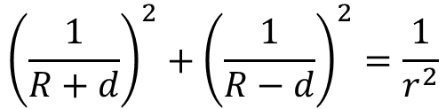
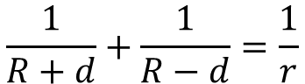
双心多边形
$$\frac{1}{R+d}+\frac{1}{R−d}=\frac{1}{r}$$
$${\left(\frac{1}{R+d}\right)}^{2}+{\left(\frac{1}{R−d}\right)}^{2}=\frac{1}{r^{2}}$$
两个满足半径和圆心距约束的圆可以作无数个双心多边形

Slide 51
彭赛列闭合定理
双心多边形的每组跨度相同的对角线都外切于一圆，且该圆与双心多边形的内切圆和外接圆共轴

Slide 52
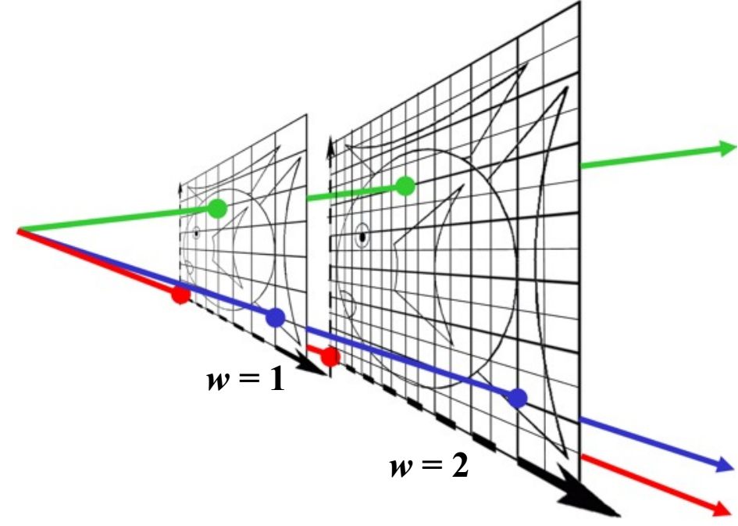
Why bother with extra coordinate?
This picture gives away almost
the whole story.

Slide 53
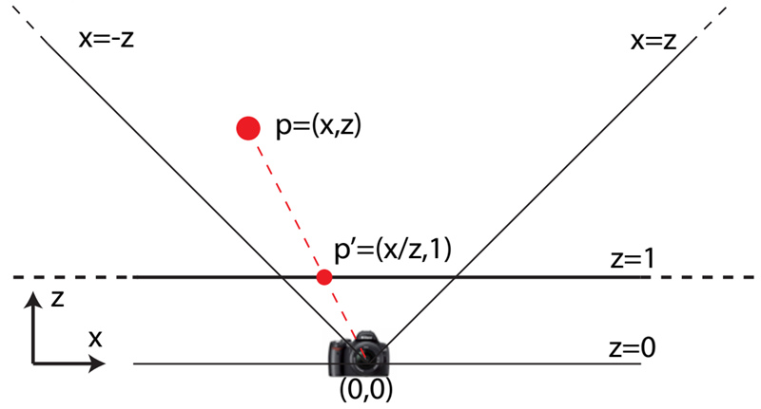
Perspective in 2D
Camera at origin, looking along z, 90 degree f.o.v., “image plane” at z = 1

Slide 54
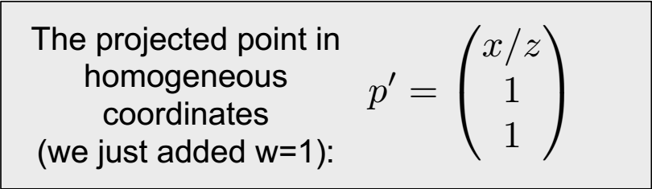
Perspective in 2D

Slide 55
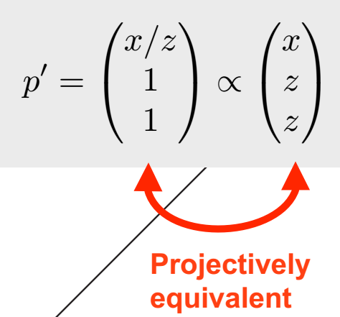
Perspective in 2D

Slide 56
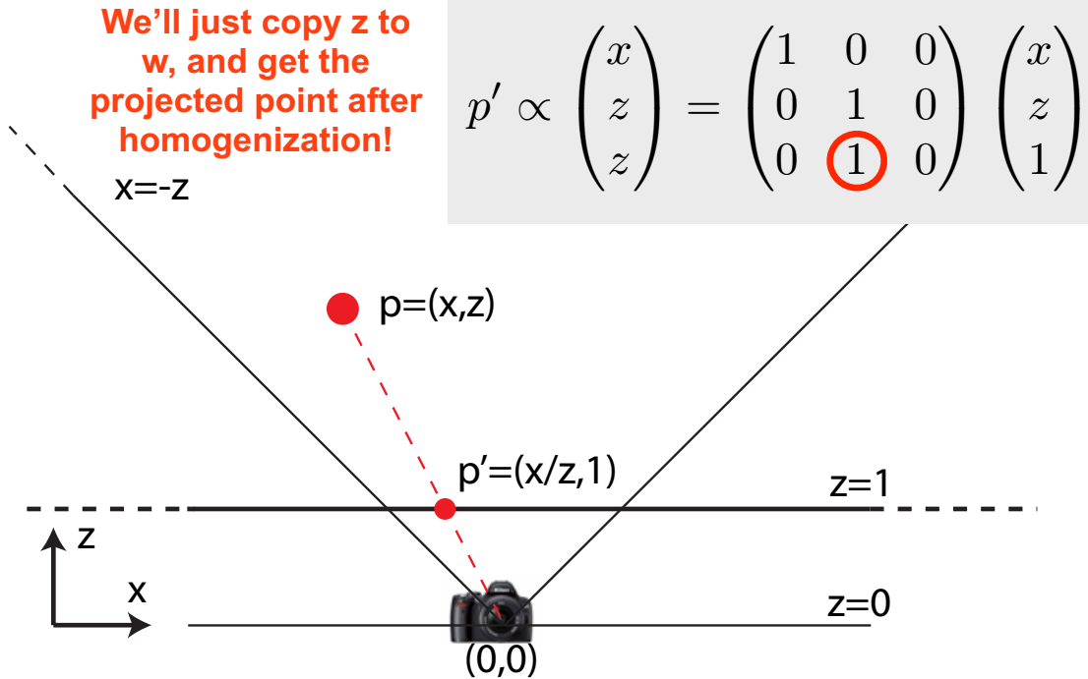
Perspective in 2D

Slide 57
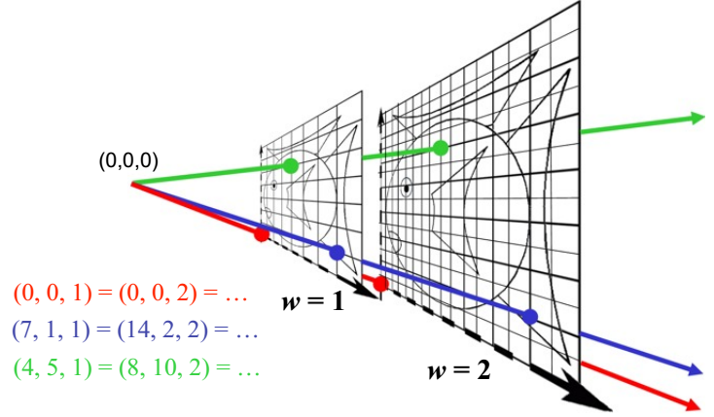
Homogeneous Visualization in 2D
Divide by w to normalize (project)

Slide 58
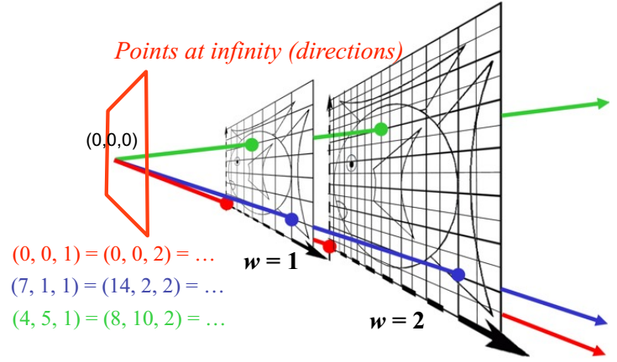
Homogeneous Visualization in 2D
Divide by w to normalize (project)
w = 0?

Slide 59
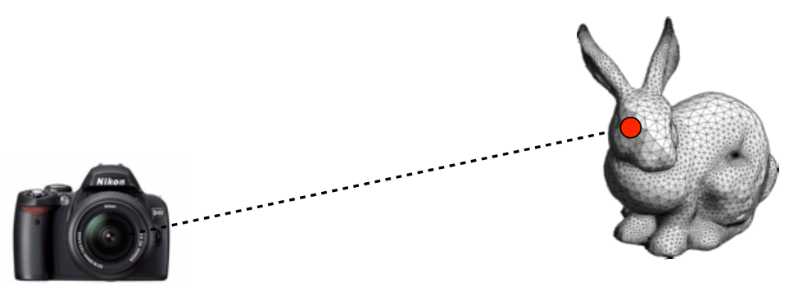
Projective Equivalence
For affine transformations, adding w=1 in the end proved to be convenient.
The real showpiece is perspective

Slide 60
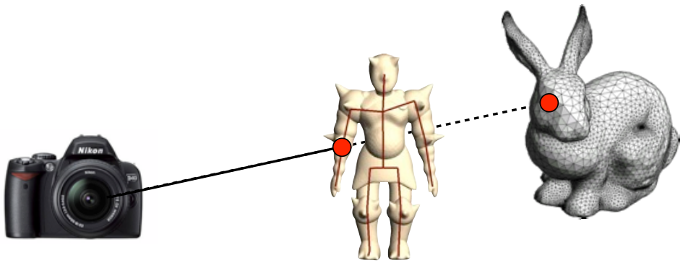
Projective Equivalence – Why?
For affine transformations, adding w=1 in the end proved to be convenient.
The real showpiece is perspective
From the camera’s point of view, all 3D points on the line fall on the same 2D coordinate in the image.
In that sense, all those 3D points are “identical”.
How many dimensions?

Slide 61
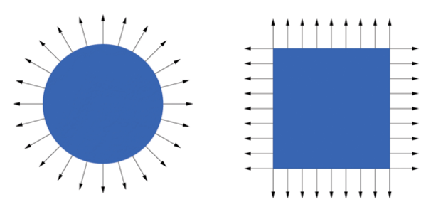
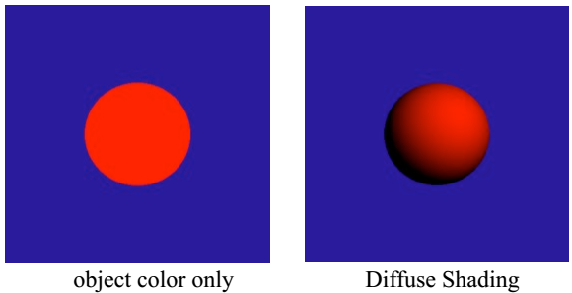
Normal
Surface Normal: unit vector that is locally perpendicular to the surface
It's used for shading — makes things look 3D!

Slide 62
Visualization of Surface Normal
±x = Red
±y = Green
±z = Blue

Slide 63
How do we transform normals?
n_{OS}
n_{WS}
Object Space World Space

Slide 64
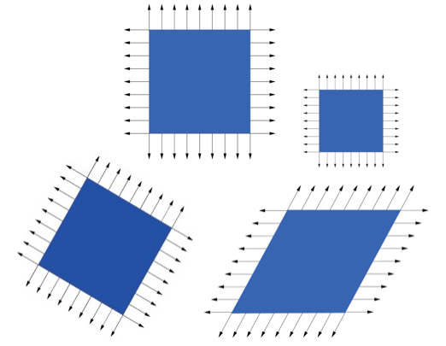
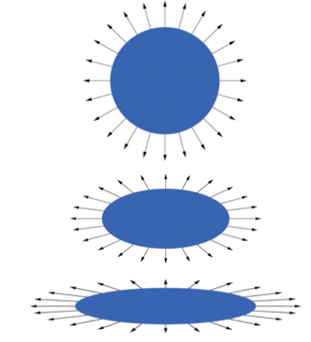
Transform Normal like Object?
Translation? Rotation? Isotropic scale? Scale?
Reflection? Shear? Perspective?

Slide 65
Transformation for shear and scale
Incorrect
Normal
Transformation
Correct
Normal
Transformation

Slide 66
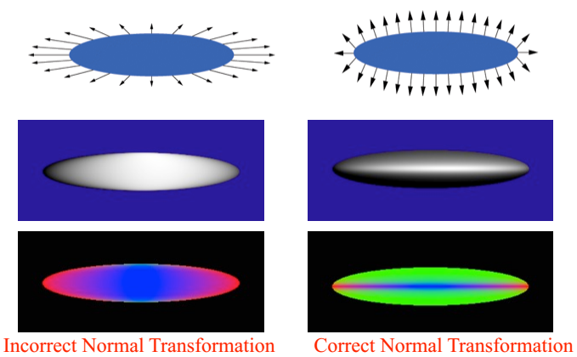
More Normal Visualizations

Slide 67
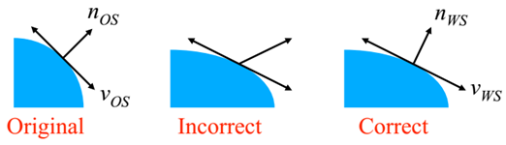
How to do it right?
Think about transforming the tangent plane to the normal, not the normal vector
Pick any vector vOs in the tangent plane,
How is it transformed by matrix M?
v_{WS} = Mv_{OS}

Slide 68
Transform tangent vector v
v is penpendicular to normal n:
Dot product
n_{OS}^{T}v_{OS} = 0
n_{OS}^{T}(M^{–1}M)v_{OS} = 0
(n_{OS}^{T}M^{–1})(Mv_{OS}) = 0
((M^{–1})^{T}n_{OS})^{T}(Mv_{OS}) = 0
n_{WS}^{T}v_{WS} = 0
v_{WS} = Mv_{OS}
n_{WS} ∥ (M^{–1})^{T}n_{OS}

Slide 69
Comment
So the correct way to transform normals is:
n_{WS} = (M^{–1})^{T}n_{OS}
But why did n_{WS} = Mn_{OS} work for similitudes?
Because for similitude / similarity transforms,
(M^{–1})^{T} = M
e.g. for orthonormal basis:
M^{–1} = M^{T}, i.e. (M^{–1})^{T} = M

